Slide 1
Algorithms Graphs
CSE 464/574
Spring 2019

Slide 2
graphs
Graph. Set of vertices connected pairwise by edges.
Why study graph algorithms?
Thousands of practical applications.
Hundreds of graph algorithms known.
Interesting and broadly useful abstraction.
Challenging branch of computer science and discrete math.

Slide 3
Graph applications
graph | vertex | edge
communication | telephone, computer | fiber optic cable
circuit | gate, register, processor | wire
mechanical | joint | rod, beam, spring
financial | stock, currency | transactions
transportation | intersection | street
internet | class C network | connection
game | board position | legal move
social relationship | person | friendship
neural network | neuron | synapse

Slide 4
Graph terminology
Path.
Sequence of vertices connected by edges.
Cycle.
Path whose first and last vertices are the same.
Two vertices are connected if there is a path between them.

Slide 5
Some graph-processing problems
problem | description
s-t path | Is there a path between s and t ?
shortest s-t path | What is the shortest path between s and t ?
cycle | Is there a cycle in the graph ?
Euler cycle | Is there a cycle that uses each edge exactly once ?
Hamilton cycle | Is there a cycle that uses each vertex exactly once ?
connectivity | Is there a way to connect all of the vertices ?
biconnectivity | Is there a vertex whose removal disconnects the graph ?
planarity | Can the graph be drawn in the plane with no crossing edges ?
graph isomorphism | Do two adjacency lists represent the same graph ?
Challenge. Which graph problems are easy? difficult? intractable?

Slide 6
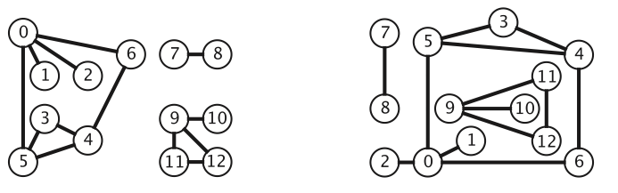
Undirected graph
Graph drawing. Provides intuition about the structure of the graph.
Two drawings of the same graph
Caveat. Intuition can be misleading.

Slide 7
Graph API
public class Graph {
Graph(int v) // create an empty graph with V vertices
Graph(In in) // create a graph from input stream
void addEdge(int v, int w) // add an edge v-w
Iterable<Integer> adj(int v) // vertices adjacent to v
int v() // return number of vertices
int e() // return number of edges

Slide 8
Graph API: sample client
Graph input format.
13 13
0 5
4 3
0 1
9 12
6 4
5 4
0 2
11 12
9 10
0 6
7 8
9 11
5 3
% java Test tinyG.txt
0-6
0-2
0-1
0-5
1-0
2-0
3-5
3-4
⋮
12-11
12-9
In in = new In(args[0]);
Graph G = new Graph(in);
for (int v = 0; v < G.V(); v++)
for (int w : G.adj(v))
StdOut.println(v + "-" + w);

Slide 9
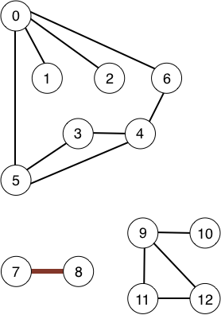
Graph representation: set of edges
Maintain a list of the edges (linked list or array).
Question: How long to iterate over vertices adjacent to v ?
Consider vertices adjacent to 0.
Now, vertices adjacent to 5
0 1
0 2
0 5
0 6
3 4
3 5
4 5
4 6
7 8
9 10
9 11
9 12
11 12

Slide 10
Graph representation: adjacency matrix
Maintain a two-dimensional V-by-V boolean array; for each edge v–w in graph:
adj[v][w] = adj[w][v] = true.
Question: How long to iterate over vertices adjacent to v ?
 | 0 | 1 | 2 | 3 | 4 | 5 | 6 | 7 | 8 | 9 | 10 | 11 | 12
0 | 0 | 1 | 1 | 0 | 0 | 1 | 1 | 0 | 0 | 0 | 0 | 0 | 0
1 | 1 | 0 | 0 | 0 | 0 | 0 | 0 | 0 | 0 | 0 | 0 | 0 | 0
2 | 1 | 0 | 0 | 0 | 0 | 0 | 0 | 0 | 0 | 0 | 0 | 0 | 0
3 | 0 | 0 | 0 | 0 | 1 | 1 | 0 | 0 | 0 | 0 | 0 | 0 | 0
4 | 0 | 0 | 0 | 1 | 0 | 1 | 1 | 0 | 0 | 0 | 0 | 0 | 0
5 | 1 | 0 | 0 | 1 | 1 | 0 | 0 | 0 | 0 | 0 | 0 | 0 | 0
6 | 1 | 0 | 0 | 0 | 1 | 0 | 0 | 0 | 0 | 0 | 0 | 0 | 0
7 | 0 | 0 | 0 | 0 | 0 | 0 | 0 | 0 | 1 | 0 | 0 | 0 | 0
8 | 0 | 0 | 0 | 0 | 0 | 0 | 0 | 1 | 0 | 0 | 0 | 0 | 0
9 | 0 | 0 | 0 | 0 | 0 | 0 | 0 | 0 | 0 | 0 | 1 | 1 | 1
10 | 0 | 0 | 0 | 0 | 0 | 0 | 0 | 0 | 0 | 1 | 0 | 0 | 0
11 | 0 | 0 | 0 | 0 | 0 | 0 | 0 | 0 | 0 | 1 | 0 | 0 | 1
12 | 0 | 0 | 0 | 0 | 0 | 0 | 0 | 0 | 0 | 1 | 0 | 1 | 0

Slide 11
Graph representation: adjacency lists
Maintain vertex-indexed array of lists.
Question: How long to iterate over vertices adjacent to v ?

Slide 12
Graph representations
In practice. Use adjacency-lists representation.
Algorithms based on iterating over vertices adjacent to v.
Real-world graphs tend to be sparse.
huge number of vertices, small average vertex degree

Slide 13
Graph representations
Representation | Space | Add edge | edge between v and w? | iterate over vertices adjacent to v?
list of edges | E | 1 | E | E
adjacency matrix | V ² | 1 * | 1 | V
adjacency lists | E + V | 1 | degree(v) | degree(v)
* disallows parallel edges

Slide 14
Adjacency-list graph representation: Java implementation
public class Graph
{
private final int V;
private Bag<Integer>[] adj;
public void addEdge(int v, int w)
{
adj[v].add(w);
adj[w].add(v);
}
public Iterable<Integer> adj(int v)
{
return adj[v];
}
public Graph(int V)
{
this.V = V;
adj = (Bag<Integer>[]) new Bag[V];
for (int v = 0; v < V; v++)
adj[v] = new Bag<Integer>();
}

